Slide 1




9th Edition TECHgium®
PID No. TG0910551
Virtual POC Round
MindFlow: LLM-Driven Rubric Evaluator for Flowcharts, Algorithms & Pseudocode
Author 1
Photo
Author 2
Photo
Author 3
Photo
Author 4
Photo
Jeet Nakrani
Dhiraj Nair
Shubham Vishwakarma
Anjali Deshmukh
Mukesh Patel School of Technology Management & Engineering (NMIMS), Mumbai, Maharashtra

Slide 2

Challenge Statement
Understanding the Problem
Challenge Requirement
Organizations frequently onboard fresh graduates and lateral hires as part of their upskilling and workforce development initiatives. To assess computational and logical thinking skills, learners are asked to create flowcharts, algorithms, and pseudocode. The challenges observed are:
The objective is to develop an intelligent, automated evaluation system capable of:
Parse text and visual inputs into structured representations for rubric-based evaluation.
Generate consistent, timely feedback with annotated outputs and rubric-aligned scores.
Inconsistent Evaluation & Interpretation Challenges
Evaluate pseudocode in a fully language-agnostic manner across diverse formats and conventions.
Time-Consuming Review Process
Human Error & Oversight
Support scalable automated assessment through seamless LMS integration.
Lack of Automated Platforms

Slide 3
Concept / Proposed Solution
The proposed solution uses an LLM-enabled evaluation engine to convert diverse submissions (flowcharts, pseudocode) into a structured graph representation.
The system performs semantic reasoning and logic validation against predefined rubrics to ensure fair, consistent, and language-agnostic assessment.
It generates annotated feedback reports, highlighting errors and providing detailed suggestions, accelerating the learner's understanding and development cycle
Key Pillars of the Solution
Multi-Format Intelligent Parsing
Unified Structured Representation
LLM-Powered Rubric Evaluation Engine
Automated Feeback & Visualization
Accepts .png, .jpg, .pdf, .docx, .pptx, .txt
Uses OCR & document parsing
Flowchart-to-Graph conversion
Semantic understanding
Graph reusing (paths, decisions)
Compares against rubric
Scores, explanations, suggestions
Annotated diagrams, error highlights
PDF / JSON reports, rubric scoring
Evaluator overrides, LMS return
Internal Model
Graph (nodes + edges), AST/IR
Normalizes pseudocode

Slide 4

SWOT Analysis
STRENGTHS
WEAKNESS
Specialized Logic Evaluation: Utilizes Vision-Language Transformer to asses flowcharts, pseudocode, and algorithm coursework.
Socratic AI Coaching: Uses Llama-3 to guide students through questioning rather than just providing answers.
Customizable Rubrics: Allows instructors to link bespoke evaluation criteria to specific assignments.
Modern UX: Features a glassmorphism-inspired UI with high-fidelity interaction simulations.
Rubric Sensitivity: The system's accuracy is strictly bound to the quality of the input rubrics; vague criteria can lead to inconsistent LLM evaluation.
OCR Resolution Sensitivity: Accuracy is dependent on the quality and resolution of uploaded flowchart images for effective text and shape detection.
OPPORTUNITIES
THREATS
Corporate L&D Integration: High demand in corporate sectors for automated, large-scale logic assessment during fresh hire onboarding and upskilling programs.
LMS Ecosystem Interoperability: Designed for seamless API integration with major platforms (Moodle, Canvas) to automate grade syncing and report generation.
Real-time AI Coaching: Expansion of the existing "AI Coach" feature to provide immediate, interactive tutoring during the coursework creation process.
Training Data Scarcity: The need for a diverse, high-quality dataset of flowcharts and algorithms to fine-tune the model ensures it generalizes well across different drawing styles.
Adoption Resistance: Potential skepticism from traditional academic institutions regarding the reliability of AI-driven grading compared to manual review.

Slide 5
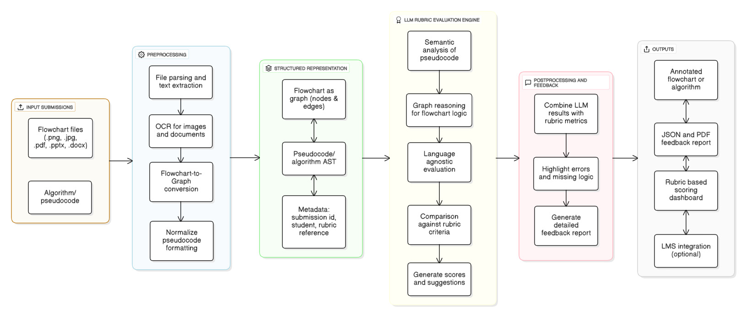
Implementation Plan

Slide 6


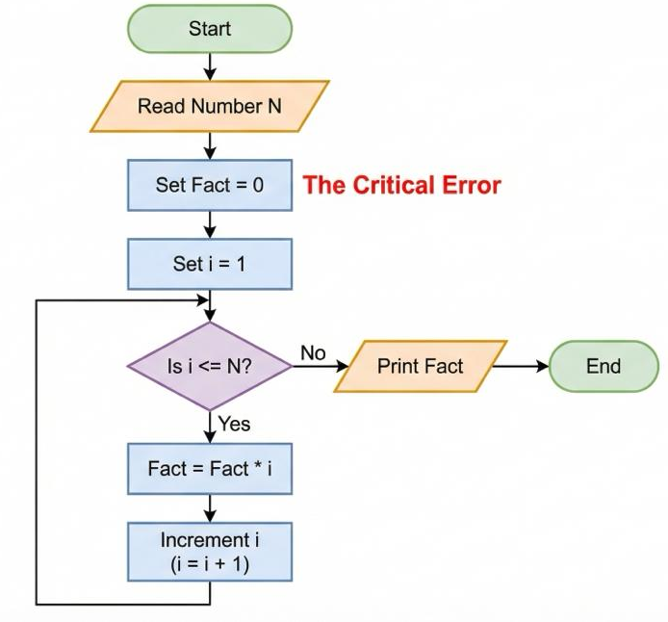
Implementation Plan
Let’s take an example….
Student Submission
MindFlow Analysis Report Rubric Score
Algorithm for Factorial Calculation Visual Focus: A flowchart containing a subtle logical error.
Logic: 2/5 | Syntax: 5/5
AI Reasoning Engine Feedback:
"Critical Logic Error Detected in Step 3.“
Issue: Mathematical Semantic Error.
Explanation: The variable is initialized to 0. Multiplying any number by 0 results in 0, breaking the factorial logic.
Correction: Change initialization to
Fact
The Problem:
The student initialized the variable to 0. In a multiplication loop, this means the answer will always be 0. A standard syntax checker would pass this, but MindFlow catches it.
Set Fact = 1

Slide 7
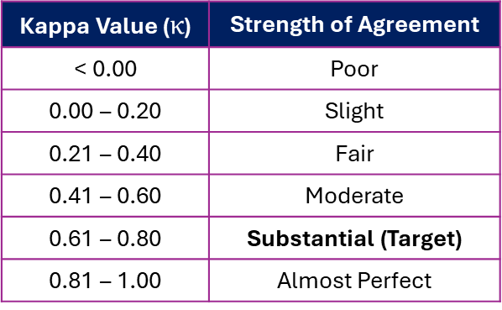

Validation / Testing / Analysis
Testing Metrics
Cohen's Kappa ($κ$) : The standard and most robust statistical measure for assessing inter-rater reliability (or agreement) when dealing with categorical or ordinal scores, which is exactly what rubric-based system produces.
$$=\frac{Observed Agreement −Expected Agreement}{1 −Expected Agreement}$$
$$κ$$
Formula Concept:
This normalization results in a score that accurately reflects the true reliability of your LLM.
Analysis
Rubric Effectiveness: Confirmed by rigorous Edge Case Testing (e.g., infinite loops, syntax errors) across different rubric types to ensure correct flaw identification.
Kappa Value ($κ$) | Strength of Agreement
< 0.00 | Poor
0.00 – 0.20 | Slight
0.21 – 0.40 | Fair
0.41 – 0.60 | Moderate
0.61 – 0.80 | Substantial (Target)
0.81 – 1.00 | Almost Perfect
Fidelity:
How accurately the feedback identifies the real error in the student’s work and explains it clearly focused on the quality of the explanation, not just the score

Slide 8

POC / Prototype Demo

Slide 9
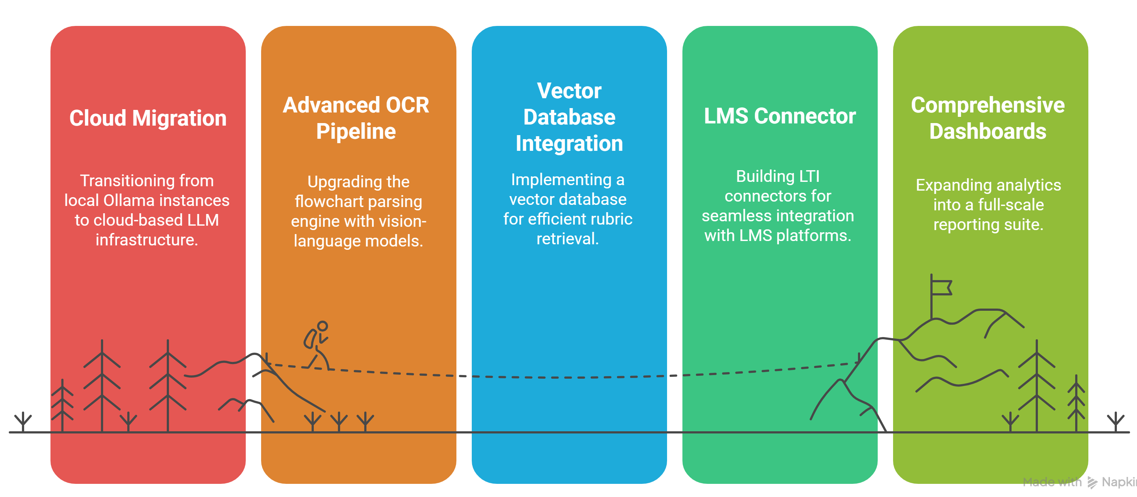
High Level plan for converting POC to MVP

Slide 10
Cost for POC vs MVP
Cost Category | PoC (₹) | MVP (₹) | Description
Model Training & Fine-Tuning | NA | 10,000 – 20,000 | Fine-tuning T5-based LLM for rubric-driven evaluation.
Parsing & Conversion Pipeline | NA | 8,000 – 15,000 | OCR, flowchart-to-graph conversion, pseudocode-to-AST/IR.
Evaluation Engine (LLM Inference) | ~1,500 – 2,000 | 6,000 – 10,000 / month | GPU/Cloud compute needed for LLM inference.
Testing & Validation | NA | 5,000 – 12,000 | Accuracy (Kappa), consistency tests, edge-case evaluation.
Deployment & Maintenance | ~1,500 – 2,000 | 5,000 – 12,000 / month | Hosting, storage, monitoring, LMS integration support.
Personnel | NA (self/research) | 2,00,000 – 3,00,000 | Development of parsing modules, evaluation engine, reporting, LMS adapter.
Note: -
The above cost estimate is approximate and may vary based on project scope, resource availability, and specific requirements.
Total PoC Estimated Cost: ₹3,000 – ₹4,000
Total MVP Estimated Cost: ₹2,30,000 – ₹3,60,000 + Monthly ₹11,000 – ₹22,000

Slide 11




Result & Conclusion
High-Fidelity Parsing:
Successfully achieved automated extraction of logic from both visual (OCR-based flowcharts) and textual (pseudocode/algorithms) formats with high semantic accuracy.
Language-Agnostic Validation:
Demonstrated the ability to evaluate logic across various pseudocode conventions without being restricted to specific programming language syntax.
Actionable Feedback:
Generated annotated feedback and rubric-aligned scores that improved student understanding of logical errors.
Reduced Evaluation Latency:
Cut down manual grading time significantly per instructor through automated rubric-based scoring.

Slide 12
References
OpenAI. Large Language Models for Code Understanding and Reasoning — Documentation & Model Behavior Insights.
Google Research. T5: Text-to-Text Transfer Transformer — Architecture and Fine-Tuning Framework.
Microsoft. OCR & Document Intelligence — Techniques for Multi-Format Parsing and Text Extraction.
ISO/IEC. Software and Systems Engineering — Rubric-Based Evaluation Standards — Guidelines for structured assessment frameworks.
IEEE. Graph-Based Algorithms for Flowchart Parsing — Methods for node/edge extraction and logic validation.
Moodle & Canvas Developer Docs. LMS Integration APIs — Standards for automated grading and report return.

Slide 13
Thank You

